Slide 1
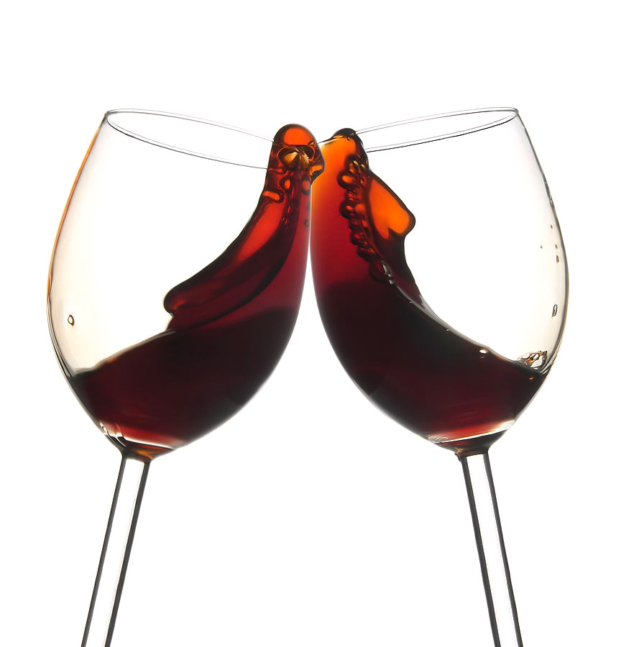
AustWineApp Project
Maxwell Barrah

Slide 2
Project Background.
AusWineApp - WineFinder.
App provides wine information to users.
The information varies from basic to advanced.
App features.
New CellarApp

Slide 3
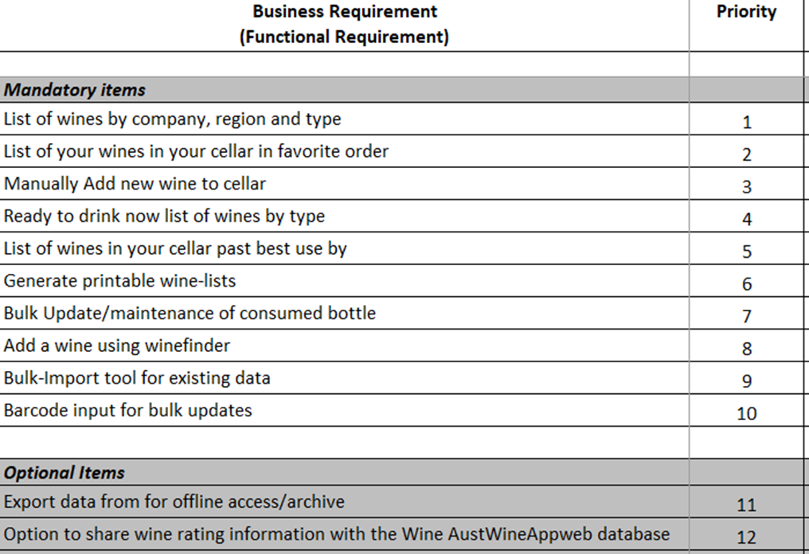
Functional and Non-functional Requirements.
android app for beta release
all information is stored in a database on the android device
Share rating with AustWineApp database

Slide 4
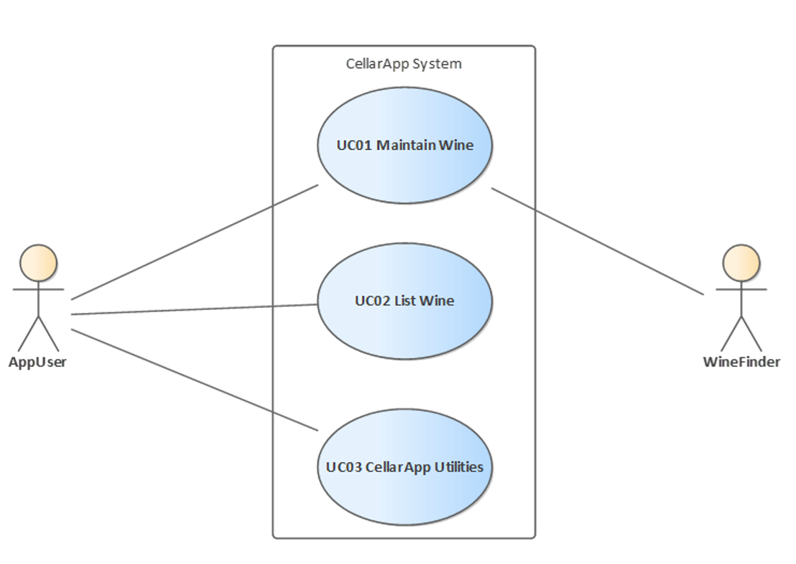
Use Case Diagrams.

Slide 5
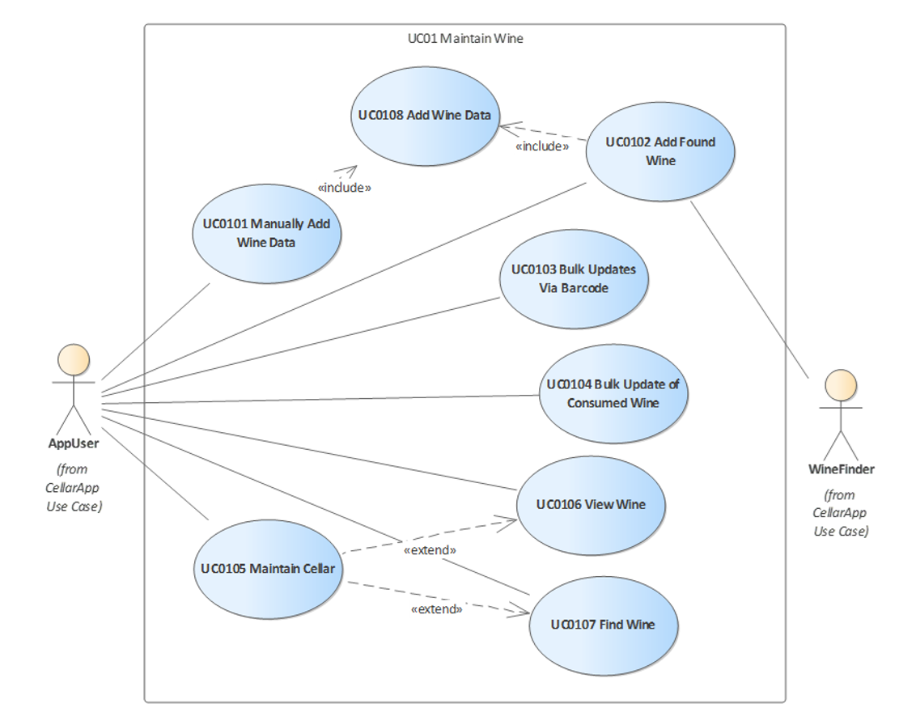
Use Case Diagrams.

Slide 6
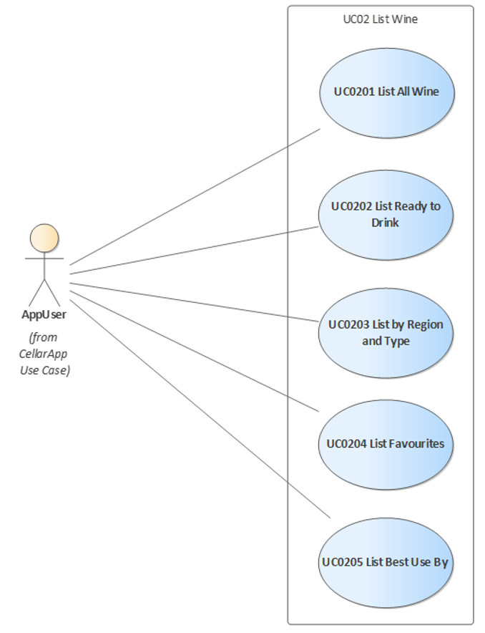
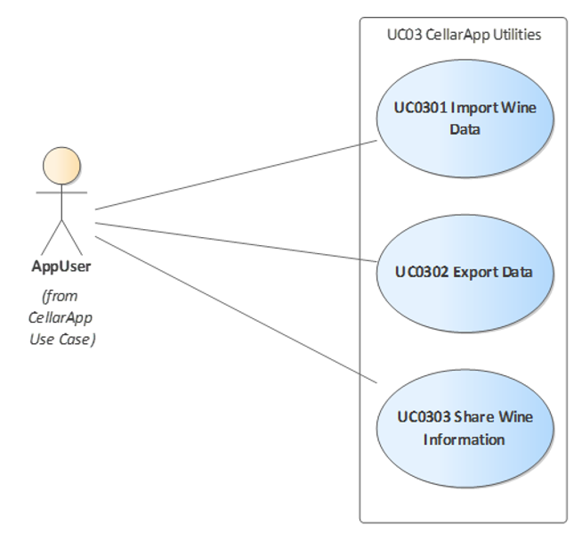
Use Case Diagrams.

Slide 7
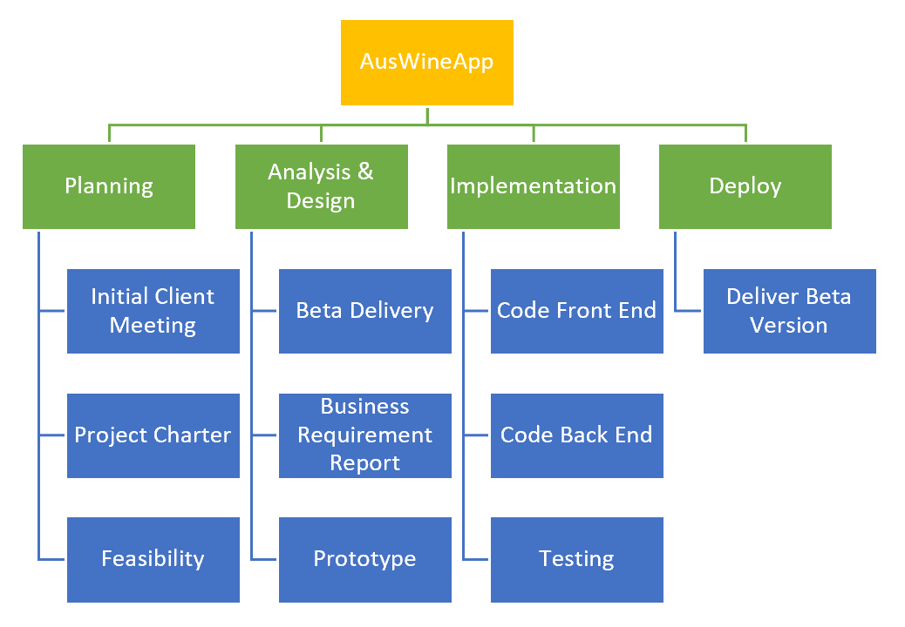
Work Breakdown Structure.

Slide 8
Project Milestones and Project Timeline.
Project Milestones:
Project charter. Due mid June.
Project plan & requirements. Due end June.
Project Feasibility. Due mid August.
Project Prototype. Due end August.
Start Development. Due in September.
Complete Beta. Due start of December.
Project Timeline:
•Stage 1 Finalize documentation & confirm.
•Stage 2 Prototype, begin development.
•Stage 3 Complete beta by Start of December.
•Stage 4 Complete working version.

Slide 9
Feasibility, Alternative 1 – Native Mobile App.
Benefits
Delivers a whole experience on a mobile device.
Native mobile applications deliver high performance.
Does not require internet connection.
User friendly.
Disadvantages
Can be expensive to develop.
May be difficult for maintenance.
Can be hard to find.

Slide 10
Feasibility, Alternative 2 – Web App.
Benefits
Short Development Period.
Easily accessible.
Cheaper to develop.
Does not need to be downloaded.
No compatibility issues as versions are the same for all users.
Accessible on numerous platforms and browsers.
Disadvantages
Always requires internet connection to use.
Can be not as reliable.
Can not perform as well as Mobile Apps.

Slide 11
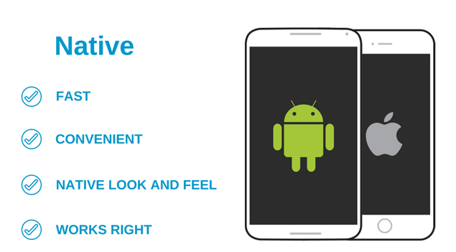
Recommendation – Native Mobile App.
15 Systems operating.
2 phases, Beta - December & Full Release

